Slide 1
Literature Review

Slide 2
Scene Descriptor Module
Scene descriptor module provides detailed descriptions of surroundings for visually impaired individuals.
Literature review shows various approaches in scene description: computer vision techniques and deep learning models.
Datasets and metrics used for evaluating scene descriptor models enable performance comparisons.
Future research should focus on addressing limitations, improving accuracy, and exploring new applications.

Slide 3
Clothes Module
Clothes description module utilizes Mask R-CNN for accurate and detailed analysis of clothing items.
Literature review highlights the use of deep learning models, specifically Mask R-CNN, for clothes segmentation and attribute recognition.
Evaluation metrics and datasets enable performance assessment and comparison of clothes description models.
Future research should focus on improving model accuracy, expanding the range of clothing categories, and enhancing real-time capabilities.

Slide 4
Modular Decomposition

Slide 5
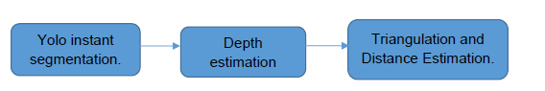
Scene Descriptor Module
COCO Dataset
Object Detection and Instant Segmentation using Yolov8
Depth Estimation using Midas
Triangularization and Distance Estimation

Slide 6
COCO Datset
Dataset Description
Training With COCO dataset
Advantages and limitations

Slide 7
Object Detection and Instant Segmentation using Yolov8
Architecture and Worflow
Bounding boxes prediction
Class Probability Prediction
Instant Segmentation
Non-Maxima Suppression
Training YOLOv8

Slide 8
Depth Estimation using Midas
Architecture and Workflow
Training Midas
Depth Map Post-processing
Heat map Generation

Slide 9
Triangularization and Distance Estimation
Heat map conversion to grayscale
Triangularization parameters
distance to object = (object width in real life * focal length) / (object pixel width in image * depth value)
Y = a * X + b, where Y represents the distance to the object (in centimeters), X represents the calculated value (object width in real life) / (object pixel width in image * depth value), and "a" and "b" are constants.
Obtaining values of X
Plotting distance estimation functions

Slide 10
Clothes Module
Dataset Preparation
Mask R-CNN
Texture Detection
Color Detection
Dataset Preparation
Mask R-CNN
Texture Detection
Color Detection

Slide 11
Dataset Preparation
DeepFasion2 Dataset
Clothing Detection E-commerce Dataset
Custom Texture Dataset
Dataset Annotation

Slide 12
Mask R-CNN
Architecture and workflow (RPN and Head)
Instant Segmentation

Slide 13
Texture Detection
Data Loading and Preprocessing
Loading
Resizing
Split Shuffling
Feature Selection and Extraction
GLCM
Daisy
PCA
Standardization
Model Selection and Training
KNN
ANN
SVM
Random Forest
Performance Analysis
Data Loading and Preprocessing
Feature Selection and Extraction
Model Selection and Training
Performance Analysis

Slide 14
Color Detection
Process segmented Image
Extract most 3 dominant color
Calculate distance to the ten most principal colors
Choose colors with minimum distance

Slide 15
System Testing and Verification

Slide 16
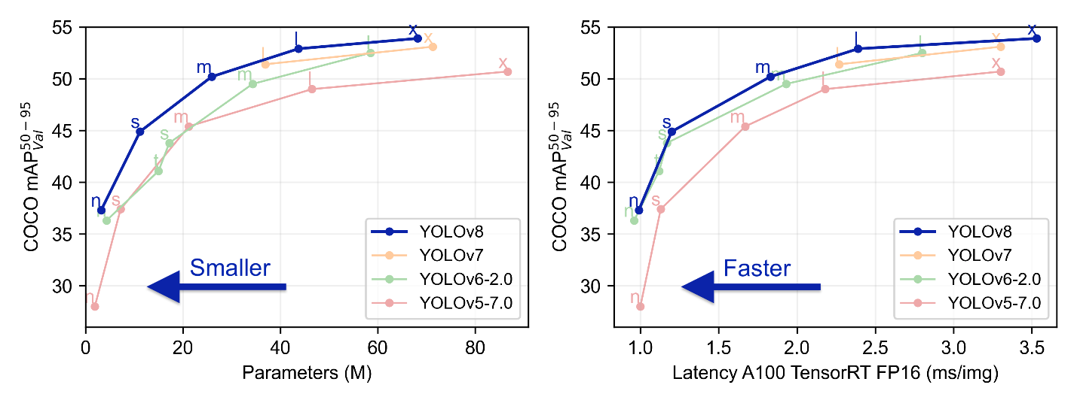
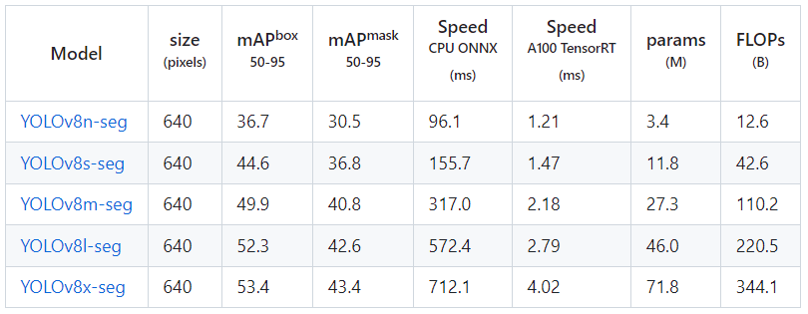
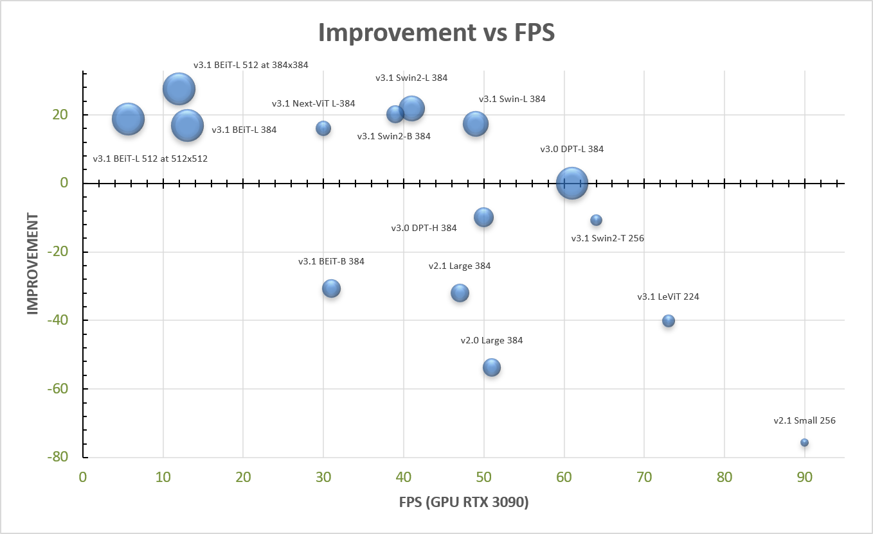
Scene Descriptor Module

Slide 17
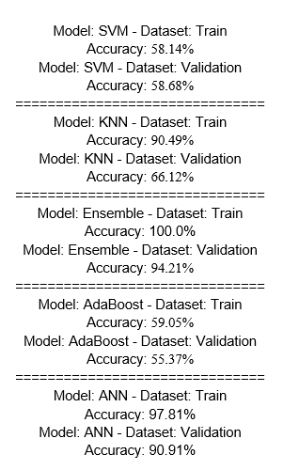
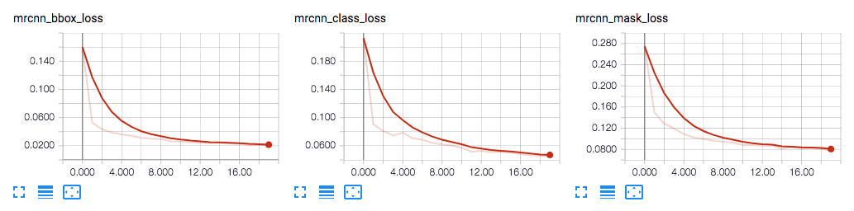
Clothes Module

Slide 18
Limitations

Slide 19
Scene Descriptor Module

Slide 20
Clothes Module

